Slide 1

DriverPass
System Analysis
Christian Tavares
Notes:
[No speaker notes required for this slide.]

Slide 2

System Requirements
The system shall allow the user to schedule driving lessons and online classes.
The system shall have several users of separate permission levels, managed by admins.
The system should be accessible online and downloadable.
The system should be very accessible and run on various platforms such as mobile.
Notes:
[To meet the needs we discussed, there are several requirements to discuss. To start, the website needs to allow students to schedule lessons and classes. Second, we need different permission levels to be managed by administrators. Then of course the system needs to be online, downloadable and very accessible.
These requirements will fulfill your needs on account that the end user can access these services to be more prepared for their driving exams. The website will be most successful by reaching as large an audience as possible, while providing us a larger range of tools that we can also access to provide better service through roles and permissions.]

Slide 3
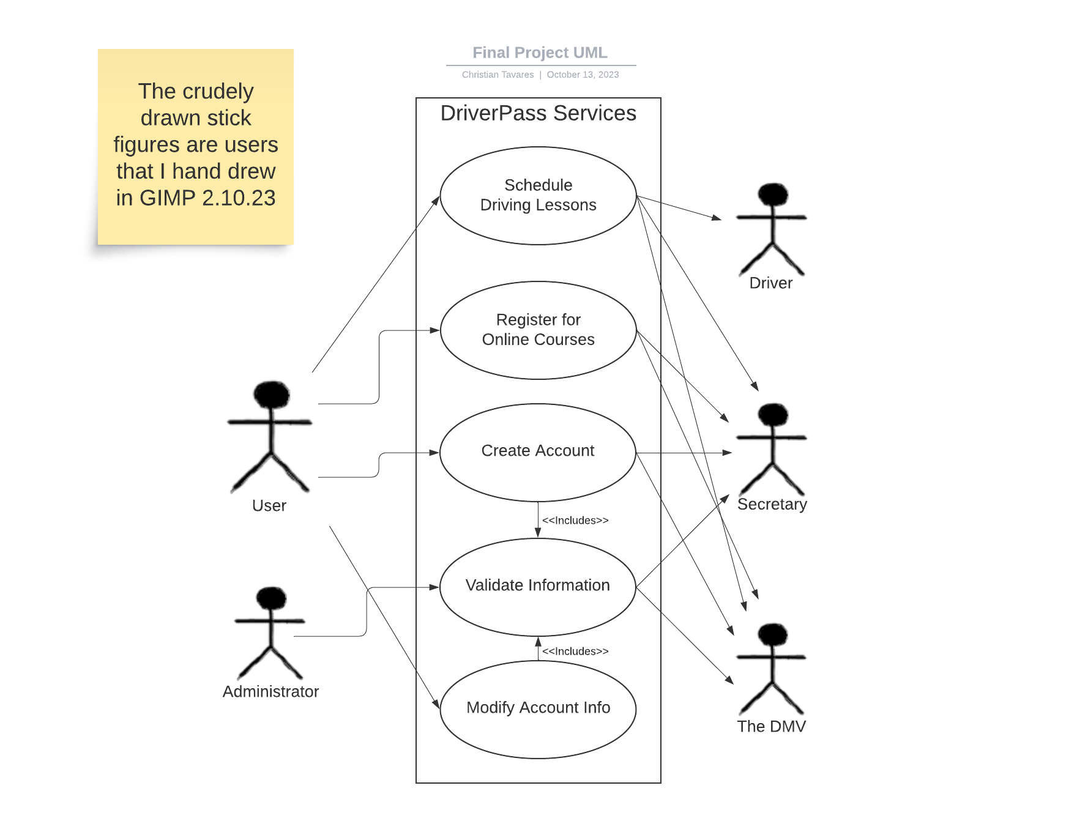
Use Case Diagram
Notes:
[In this diagram we can see an overview of our system, what it is capable of and which parties are involved in those circumstances. As previously established, the system needs to be able to schedule driving lessons and courses to enroll in. The left side of this diagram contains users of the website, whereas the right are the parties affected by the task in the system. The DMV will have a place in this diagram to show that there is outsourced validation in our courses and identification process.
Finally the thing to remember here is that this diagram accounts for the user being able to contact a secretary to do the tasks in our system. They have the option to do so either online, or through a secretary. The administrator in this diagram is in charge of overseeing any changes to personal information that needs to be validated.]

Slide 4
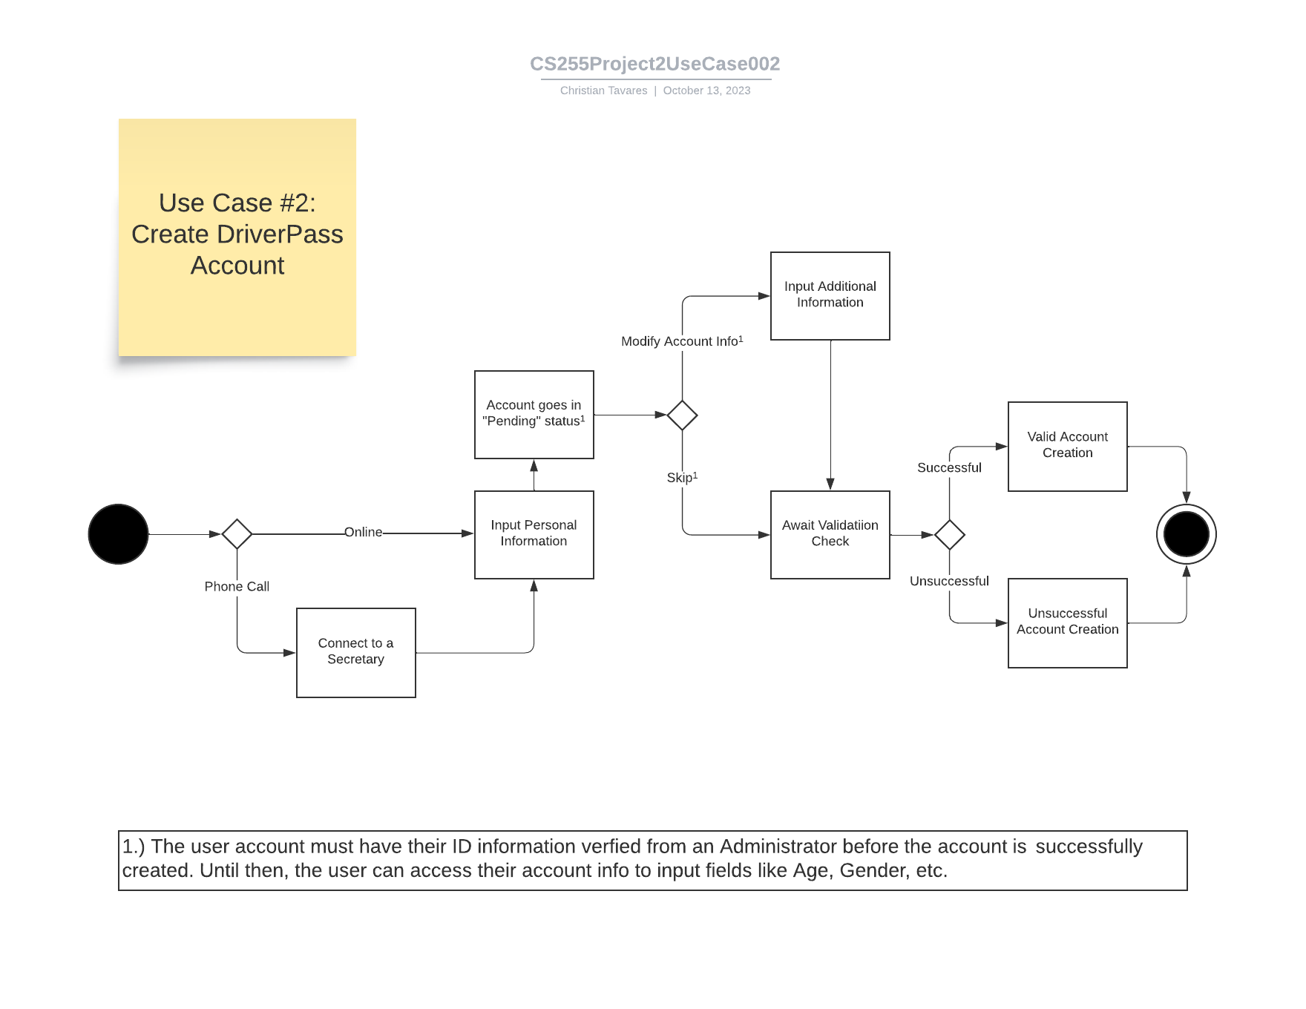
Activity
Diagram
Notes:
[This use case diagram will show the process of a user creating an account. Starting from the left, we begin with establishing if this is done over the phone remotely, or online. Phone calls have the additional step of having a secretary input this information for you before being pushed to the user account reaching a “pending” status. This needs to be done in order to verify the user's identification info. This process will happen in the background through the help of an administrator.
After this, the user may choose to input any personal information like their age and gender here. This is always available once the account is pending if the use chooses to input this later. After this, the account simply needs to await the verification process. It will either be successfully created, or it fails the process and the account is canceled]

Slide 5
Security
Accounts will be ID verified with the DMV itself to ensure safety.
Site users will have a role system established for their permissions.
Administrators will oversee the operation of the site with aid of the site's audit log for any events.
Account will lock itself out after 3 consecutive password failures.
Password recovery will be available with valid identification.
Notes:
[As you can imagine, security is an important consideration in this system. There are a few key points I wish to touch on here. First, as mentioned with our use case diagram, accounts will be outsourced to verify identification with the DMV itself. This step is important to counteract potential identity fraud, or anything else that could make problems with creating a user account. Second is our role system. As we've discussed, there will be several roles with different permissions for those accessing the website. Our roles being Students, Secretary, Administrators and Drivers. It will allow us to easily give permissions for them to access the tools needed to complete their jobs. Administrators will oversee the smooth operation of anything done on the website through use of an audit log. This audit will have a description of any event going on and who was in charge of them.
Lastly we have an account locking system in case of password failure. Just for an extra net of account security, 3 consecutive failures of password input on the user login will lock the user's account. The account can be unlocked of course, but it will require proper ID validation like a recovery email of some kind.]

Slide 6
System Limitations
Internet features not as readily accessible to those w/ disabilities.
The system requires constant power.
The system requires a constant and stable internet connection.
Sign-in information must be accessible to reach internet features.
Notes:
[Our system will of course have some limitations to bear in mind. Firstly, this system isn't exactly an accessible tool for those with particular disabilities. That being said, this shouldn't be the worst limitation to work around since we are trying to run a service for anyone working on becoming a licensed driver. As you can imagine, a legally blind citizen would find it rather difficult to drive a motor vehicle.
The main considerations to have in this segment are that this system will require a constant stable internet connection as well as a constant stream of power. Outages of internet and power will put the entire system and database out of commission for awhile.
Lastly the user will HAVE to have access to their sign-in information in order to access the internet. Otherwise they will need to contact a secretary to do business.
With these limitations in mind, I believe that should conclude what I wanted to bring forward today. I will answer any questions you have for me.]

